Slide 1
Build data analytics solutions using Azure Synapse Analytics serverless SQL pools
Notes:
Before delivering this presentation, review the associated modules on Microsoft Learn (https://aka.ms/mslearn-synapse-serverless-sql) and complete the exercises.
Before starting your delivery, prepare a lab environment for the first demonstration by running the setup script.

Slide 2


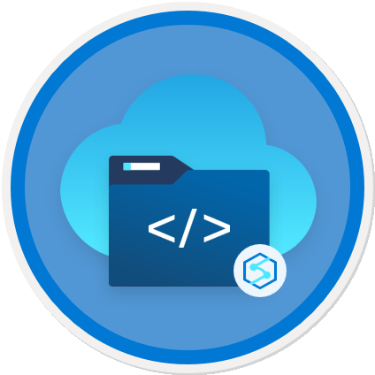
Agenda
Use a serverless SQL pool to query files in a data lake
Use a serverless SQL pool to transform data
Create a lake database

Slide 3
Use a serverless SQL pool to query files in a data lake

Slide 4


SQL Pools in Azure Synapse Analytics
Azure Synapse Analytics
Serverless SQL Pool
Dedicated SQL Pools
On-demand SQL query processing
Data stored as files in a data lake
Typical use cases:
Data exploration
Data transformation
Logical data warehouse
Cloud-scale relational database
Data stored in relational tables
Typical use cases:
Relational data warehouse
Enterprise business intelligence
Notes:
In this presentation, we’re going to focus on using the serverless SQL pool; but it’s worth taking some time upfront to differentiate serverless SQL workloads from dedicated SQL pool workloads. We’ll cover relational data warehousing with dedicated SQL pools later in the course.
The key differences are called out on the slide – note that the serverless SQL pool does not store data – it enables you to use a SQL processing engine to run ad-hoc queries on data in files, but it does not implement a relational store in the way a SQL Server database (or dedicated SQL pool) does. You can create external tables – essentially metadata table definitions that are “overlaid” on a data lake file system location, but there’s no data actually stored in tables in the database.

Slide 5
Query delimited text files using a serverless SQL pool
123,Widget,12.99
124,Gadget,3.99
…
Use the OPENROWSET function
Use the BULK parameter specifies file path(s)
Include wildcards as required
Use the FORMAT parameter to specify 'csv'
Use additional parameters for:
Header row
Delimiter characters
Parser version
others…
Use the WITH clause to specify column names and types
SELECT *
FROM OPENROWSET(
BULK 'https://.../data/files/*.csv',
FORMAT = 'csv',
PARSER_VERSION = '2.0')
WITH (
product_id INT,
product_name VARCHAR(20),
list_price DECIMAL(5,2)
) AS rows
product_id | product_name | list_price
123 | Widget | 12.99
124 | Gadget | 3.99
… | … | …
Notes:
The primary SQL function used to query files in a data lake is OPENROWSET. It essentially returns a tabular dataset based on data in a file system location, either deriving the tabular schema from the data itself or by applying an explicit schema of column definitions. For delimited files, you can specify explicit delimiters (tab, comma, space, etc.). The default field delimiter is comma.
Talk through the code example, which opens data from a specified CSV file and returns it as a tabular dataset based on the schema defined in the WITH clause.

Slide 6
Query JSON files using a serverless SQL pool
{
"product_id": 123,
"product_name": "Widget",
"list_price": 12.99
}
Use the OPENROWSET function
Use the BULK parameter specifies file path(s)
Include wildcards as required
Use the FORMAT parameter to specify 'csv'
Set terminators to '0x0b'
Use the WITH clause to specify a single NVARCHAR column
Use JSON_VALUE function to specify JSON properties
Specify attribute path based on JSON in the NVARCHAR column
SELECT JSON_VALUE(doc, '$.product_name') AS product,
JSON_VALUE(doc, '$.list_price') AS price
FROM
OPENROWSET(
BULK 'https://.../data/files/*.json',
FORMAT = 'csv',
FIELDTERMINATOR ='0x0b',
FIELDQUOTE = '0x0b',
ROWTERMINATOR = '0x0b'
) WITH (doc NVARCHAR(MAX)) as rows
product | price
Widget | 12.99
Gadget | 3.99
… | …
Notes:
The key point here is that there’s no specific JSON format. JSON files are treated as delimited files with specific delimiters, and the object path syntax in the JSON_VALUE function is used to navigate the JSON document hierarchy based on the resulting rowset (which consists of rows containing text values for JSON objects)

Slide 7


Query parquet files using a serverless SQL pool
orders
Use the OPENROWSET function
Use the BULK parameter specifies file path(s)
Include wildcards as required
Use the FORMAT parameter to specify 'parquet'
Use filepath property to filter by partitions
Parameters reflect ordinal position of wildcards
Not specific to parquet, but commonly used to distribute data in parquet format
year=2020
month=1
month=2
SELECT *
FROM OPENROWSET(
BULK 'https://.../data/orders/year=*/month=*/*.*’,
FORMAT = 'parquet’) AS orders
WHERE orders.filepath(1) = '2020’
AND orders.filepath(2) IN ('1','2');
order_no | order_date | order_total
1001 | 2020-01-07 | 99.78
1002 | 2020-01-12 | 11.99
… | … | …
Notes:
Parquet is generally the preferred format for working with data files in a data lake because of its efficient compression format and support across big data processing platforms (a lot of data engineering tasks involve transforming data from other formats into Parquet). Note that in most cases, the schema is embedded in the Parquet file, so a WITH clause isn’t required.
Partitioning is a technique that’s not specific to Parquet, but which is commonly used to improve scalability and performance in partnership with the optimizations inherent in the Parquet format.

Slide 8











Create external database objects
CREATE DATABASE SalesDB
COLLATE Latin1_General_100_BIN2_UTF8;
USE SalesDB;
Database
In serverless SQL pool
CREATE DATABASE SCOPED CREDENTIAL sqlcred
WITH
IDENTITY='SHARED ACCESS SIGNATURE’,
SECRET = 'sv=xxx...’;
SELECT * FROM dbo.Products;
External Table
Relational abstraction over data in external files
CREATE EXTERNAL DATA SOURCE files
WITH ( LOCATION = 'https://mydatalake.blob.core.windows.net/data/files/’,
CREDENTIAL = sqlcred);
Credential
Provides authorized access to external files
CREATE EXTERNAL FILE FORMAT CsvFormat
WITH ( FORMAT_TYPE = DELIMITEDTEXT,
FORMAT_OPTIONS(
FIELD_TERMINATOR = ',',
STRING_DELIMITER = '“’));
External Data Source
Encapsulates connection to external file storage location
CREATE EXTERNAL TABLE dbo.products
(
product_id INT,
product_name VARCHAR(20),
list_price DECIMAL(5,2)
)
WITH
(
DATA_SOURCE = files,
LOCATION = 'products/*.csv',
FILE_FORMAT = CsvFormat
);
External File Format
Defines file type and format for externally stored data
Notes:
Use the code sample on the right to walk through the various objects that need to be created to support external tables.

Slide 9

Demo: Query files using a serverless SQL pool
You can try this for yourself later by following the instructions at the link below:
https://aka.ms/mslearn-synapse-sql
Notes:
The demonstration will take around 30 minutes.
Tell students that they can try the steps for themselves after class, though they may need to use their own Azure subscription if a hosted environment is not provided.

Slide 10

Knowledge check
What function is used to read the data in files stored in a data lake?
FORMAT
ROWSET
OPENROWSET
What character in file path can be used to select all the file/folders that match rest of the path?
&
*
/
Which external database object encapsulates the connection information to a file location in a data lake store?
FILE FORMAT
DATA SOURCE
EXTERNAL TABLE
Notes:
Allow students a few minutes to think about the questions, and then use the animated slide to reveal the correct answers.

Slide 11
Use a serverless SQL pool to transform data

Slide 12
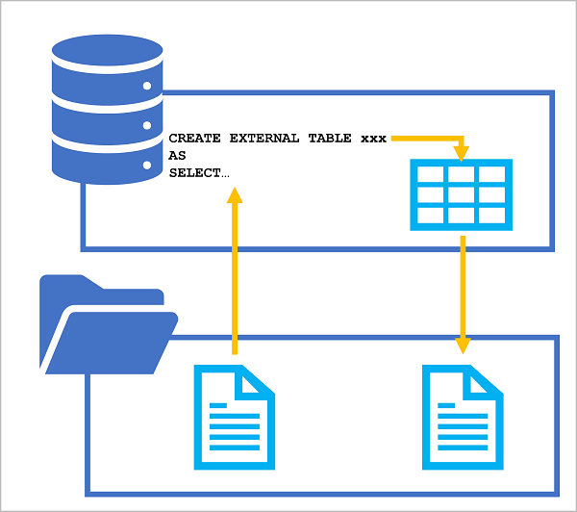
The CREATE EXTERNAL TABLE AS SELECT (CETAS) statement
CREATE EXTERNAL TABLE SpecialOrders
WITH (
-- details for storing results
LOCATION = 'special_orders/',
DATA_SOURCE = files,
FILE_FORMAT = ParquetFormat
)
AS
SELECT OrderID, CustomerName, OrderTotal
FROM
OPENROWSET (
-- details for reading source files
BULK 'sales_orders/*.csv',
DATA_SOURCE = 'files',
FORMAT = 'CSV',
PARSER_VERSION = '2.0',
HEADER_ROW = TRUE
) AS source_data
WHERE OrderType = 'Special Order';
Source data
Transformed data
(CSV or parquet)
Notes:
The CETAS statement provides a convenient way to use the results of a SQL query as the basis for a new external table, which is persisted as one or more data files in the data lake. You can use the SQL query to transform the data, and then query the resulting table or use the underlying data files in a downstream process.

Slide 13

Encapsulate data transformations in a stored procedure
Using a stored procedure:
Reduces client to server network traffic
Provides a security boundary
Eases maintenance
Improved performance
CREATE PROCEDURE Transform_Data @order_year INT
AS
BEGIN
-- Drop the table if it already exists
IF EXISTS (
SELECT * FROM sys.external_tables
WHERE name = 'SpecialOrders'
)
DROP EXTERNAL TABLE SpecialOrders
-- Create external table
CREATE EXTERNAL TABLE SpecialOrders
WITH (
...
)
END
Dropping the table doesn’t delete the underlying files
Notes:
Using a stored procedure to encapsulate the CETAS transformation makes it easier to reuse the logic as part of a regular data ingestion and transformation process. However, note that dropping the external table does not delete the underlying files; so your repeated process must take that into account. One approach would be to use a dynamically generated file path each time the stored procedure is run. Another is to delete the old files from previous transformation operations (assuming they’re no longer required) before running the stored procedure – this approach is discussed in the next slide.

Slide 14
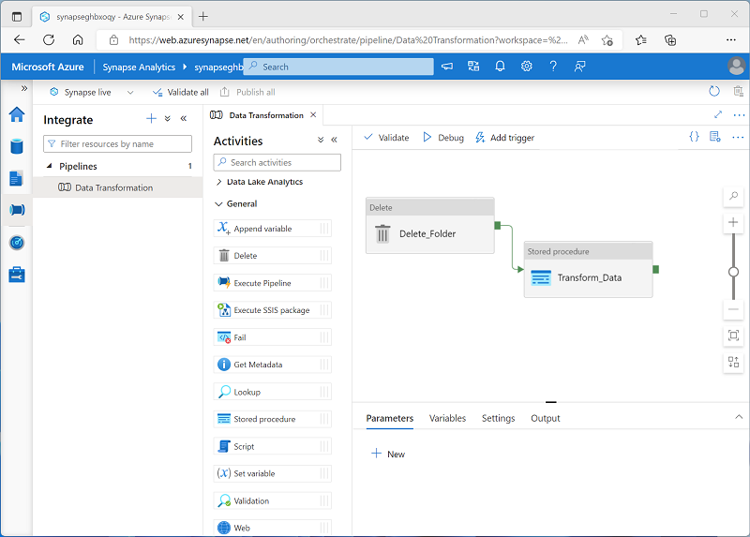
Include a data transformation stored procedure in a pipeline
Create a pipeline with the following activities:
A Delete activity that deletes the target folder for the transformed data in the data lake if it already exists.
A Stored procedure activity that connects to your serverless SQL pool and runs the stored procedure that encapsulates your CETAS operation.
Notes:
We’ll cover pipelines in greater depth later in the course, but for now, point out that by chaining delete and stored procedure activities in a pipeline like this, you can create a repeatable process for using a CETAS statement to transform data and generate new data files in the data lake, which could then be used in a downstream process (for example, to load a table in a dedicated SQL pool)

Slide 15

Exercise: Transform files using a serverless SQL pool
Use the hosted lab environment provided, or view the lab instructions at the link below:
https://aka.ms/mslearn-synapse-transform-sql
Notes:
The exercise will take a minimum of half an hour to complete, including 5 minutes or so at the start to set up the environment.
Not all students work at the same pace, so you should allow 45 minutes or more as necessary for your class.
While students are completing the exercise, you can prepare for the next demonstration by running the setup script for that exercise.

Slide 16
Knowledge check
You need to store the results of a query in a serverless SQL pool as files in a data lake.
Which SQL statement should you use?
BULK INSERT
CREATE EXTERNAL TABLE AS SELECT
COPY
Which of the following file formats can you use to persist the results of a query?
CSV only
Parquet only
CSV and parquet
You drop an existing external table from a database in a serverless SQL pool.
What else must you do before recreating an external table with the same location?
Delete the folder containing the data files for dropped table
Drop and recreate the database
Create an Apache Spark pool
Notes:
Allow students a few minutes to think about the questions, and then use the animated slide to reveal the correct answers.

Slide 17
Create a lake database

Slide 18
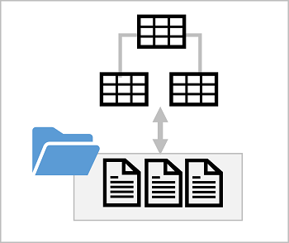

Lake database concepts
Lake database schema:
Relational tables
Proven data modeling principles
Consistent naming conventions
Lake database storage:
Parquet or CSV files in a data lake
Managed independently of database
Simplified data ingestion
Lake database compute:
Serverless SQL pool
Apache Spark pool
Notes:
The concepts here build on the previously discussed concept of external tables. In effect, a lake database is a relational schema that abstracts data in files, so data in the database can be ingested and updated directly in the file system.

Slide 19
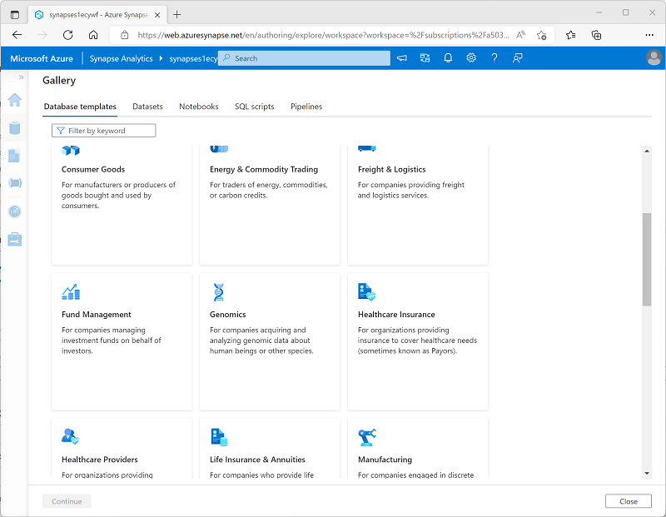
Database templates
Pre-defined relational schema based on common business scenarios
Use as a template for a new database or start with a blank schema and add pre-defined table definitions
Notes:
Point out that the database templates can be used to create a complete database schema, or you can start with a blank database and add individual tables based on the table definitions in the templates. The templates are based on common database design patterns in enterprise database scenarios; but can be customized to your specific needs.

Slide 20
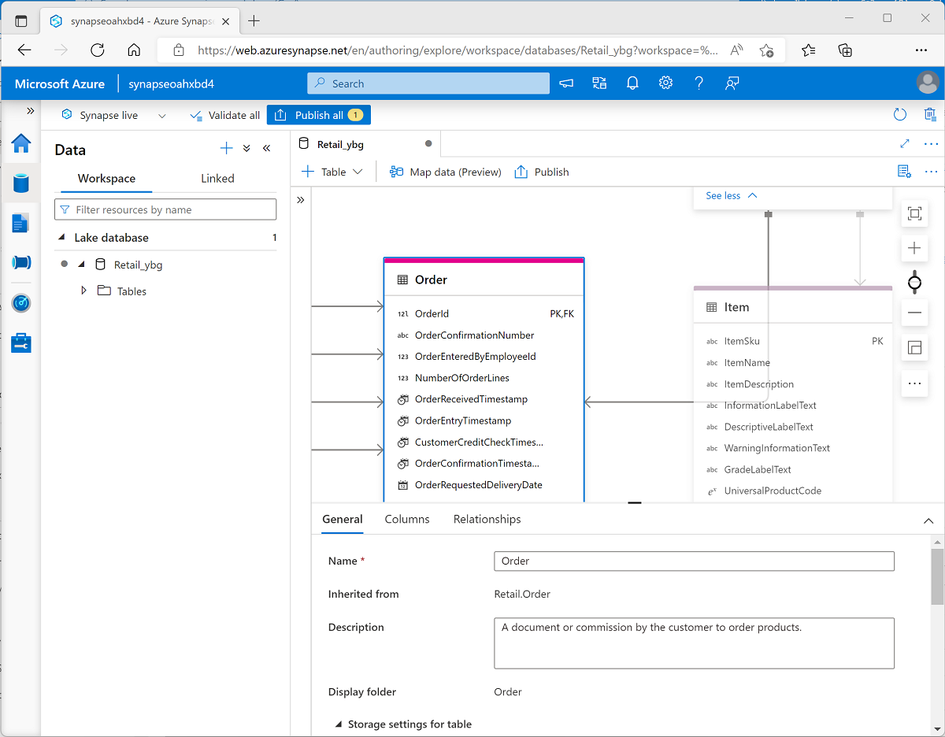
Database designer
Visual tool for creating a database schema
Add tables and specify:
Name and storage settings for the table
Names, key usage, nullability, and data types for each column
Relationships between key columns across tables
Notes:
The database designer can greatly simplify the creation of complex database schema.

Slide 21
Use a lake database
USE RetailDB;
GO
SELECT CustomerID, FirstName, LastName
FROM Customer
ORDER BY LastName;
%%sql
INSERT INTO `RetailDB`.`Customer` VALUES (123, 'John', 'Yang’)
SELECT * FROM `RetailDB`.`Customer` WHERE CustomerID = 123
Notes:
The tables in a lake database can be queried in a SQL pool, but also in a Spark pool because the database schema is defined in the metastore for Spark pools in the workspace.

Slide 22
Demo: Analyze data in a lake database
You can try this for yourself later by following the instructions at the link below:
https://aka.ms/mslearn-synapse-lakedb
Notes:
The demonstration will take around 45 minutes.
Tell students that they can try the steps for themselves after class, though they may need to use their own Azure subscription if a hosted environment is not provided.

Slide 23
Knowledge check
Which if the following statements is true of a lake database?
Data is stored in a relational database store and cannot be directly accessed in the data lake files
Data is stored in files that cannot be queried using SQL
A relational schema is overlaid on the underlying files, and can be queried using a serverless SQL pool or a Spark pool
You need to create a new lake database for a retail solution.
What's the most efficient way to do this?
Create a sample database in Azure SQL Database and export the SQL scripts to create the schema for the lake database
Start with the Retail database template in Azure Synapse Studio, and adapt it as necessary
Start with an empty database and create a normalized schema
You have Parquet files in an existing data lake folder for which you want to create a table in a lake database. What should you do?
Use a CREATE EXTERNAL TABLE AS SELECT (CETAS) query to create the table
Convert the files in the folder to CSV format
Use the database designer to create a table based on the existing folder
Notes:
Allow students a few minutes to think about the questions, and then use the animated slide to reveal the correct answers.

Slide 24

Further reading
Build data analytics solutions using Azure Synapse serverless SQL pools
https://aka.ms/mslearn-synapse-serverless-sql
Notes:
Encourage students to review the online material on Microsoft Learn on which this presentation is based.

